Slide 1

Practical 4

Slide 2
Modifying Database Tables

Slide 3
Objective
Creating and viewing constraints
Modify and delete database tables using SQL*Plus

Slide 4
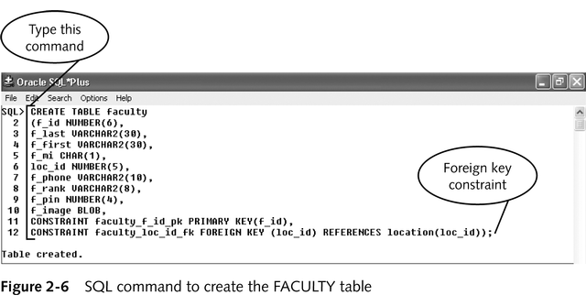
Create Table with Foreign Key Constraint

Slide 5
Viewing Information About Tables
describe tablename: displays column names and data types
Data dictionary: tables that contain information about the structure of the database.
USER: shows the objects in the current user’s schema
ALL: shows both objects in the current user’s schema and objects that the user has privileges to manipulate
DBA: allows users who are database administrators to view information about all database objects

Slide 6
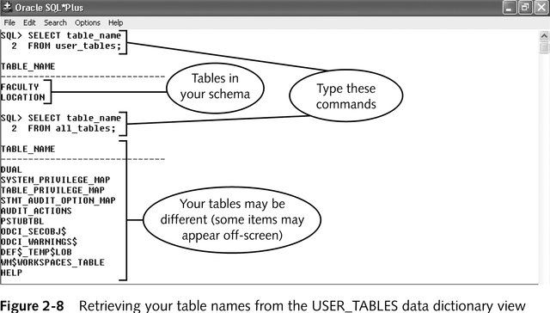
Viewing Tables in the Database

Slide 7
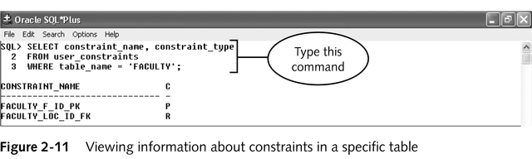
Viewing Constraints on One Table

Slide 8
Modifying and Deleting Database Tables
Modify existing database tables by:
Changing the name of a table
Adding new columns
Deleting columns that are no longer needed
Changing the data type or maximum size of an existing column
Unrestricted action: some specifications can always be modified
Restricted action: specifications modified only in certain situations

Slide 9
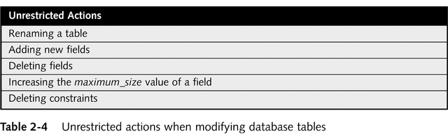
Unrestricted Action

Slide 10
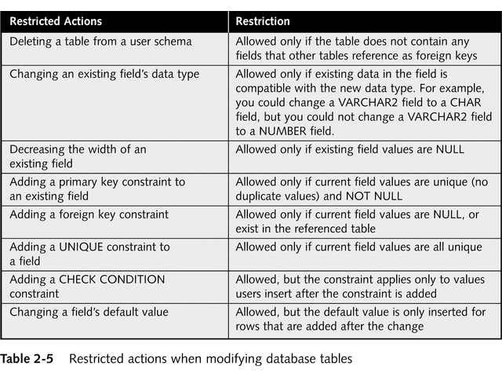
Restricted Actions

Slide 11
Deleting and Renaming Tables
To delete:
Drop table [tablename]
Use with caution
To delete foreign key constraints, add “cascade constraints”
To rename:
Rename old_tablename to new_tablename
DBMS automatically transfers to the new table integrity constraints, indexes, and privileges that referenced the old table.

Slide 12
Adding Fields to Existing Tables
To add a field:
ALTER TABLE tablename ADD(fieldname data_declaration constraints);

Slide 13
Modifying Existing Field Data Definitions
Can only change datatype to compatible data type (i.e. varchar2 to char)
ALTER tablename MODIFY(fieldname new_data_declaration);

Slide 14
Deleting a Field
ALTER TABLE tablename DROP COLUMN fieldname;
Can be used to rename a field – first drop, then add

Slide 15
Adding and Deleting Constraints
Add a constraint: ALTER TABLE tablename ADD CONSTRAINT constraint_name constraint_definition;
Remove a constraint: ALTER TABLE tablename DROP CONSTRAINT constraint_name;

Slide 16
Enabling and Disabling Constraints
When modifying a database it can be useful to disable constraints
Constraints are enabled by default
To disable a constraint: ALTER TABLE tablename DISABLE CONSTRAINT constraint_name;
To enable a constraint: ALTER TABLE tablename ENABLE CONSTRAINT constraint_name;

Slide 17
Summary
SQL commands include:
Data description language (DDL) commands: create, modify, Deleted database objects
Data manipulation language (DML) commands: insert, update, delete, view database data
To create a table:
specify the table name, the name of each data field, and the data type and size of each data field
Data types ensure correct data values
Constraints restrict values of database fields
SQL*Plus commands are not case sensitive

Slide 18
Summary
Errors include line number, position, error code
Use DESCRIBE command to display a table’s fieldnames and data types
Tables can be modified or deleted but some changes are restricted

